Slide 1
Spring and Xstream Integration (Marshalling Java Object into XML)
Xstream is a library to serialize objects to xml and vice-versa without requirement of any mapping file. Notice that castor requires an mapping file.
XStreamMarshaller class provides facility to marshal objects into xml and vice-versa.

Slide 2
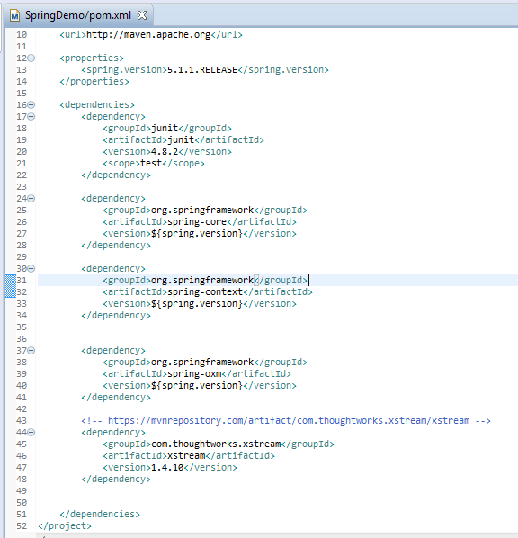
Spring and Xstream Integration (Marshalling Java Object into XML)

Slide 3
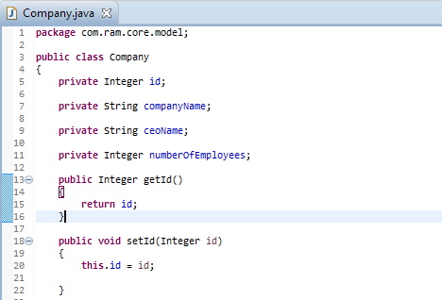
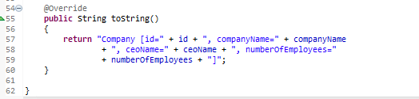
Spring and Xstream Integration (Marshalling Java Object into XML)
….
….

Slide 4
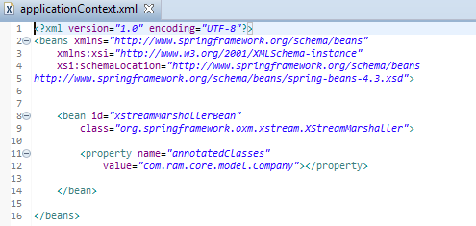
Spring and Xstream Integration (Marshalling Java Object into XML)
It defines a bean xstreamMarshallerBean where Employee class is bound with the OXM framework.

Slide 5
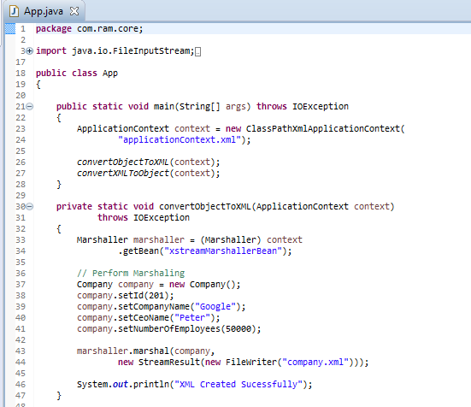
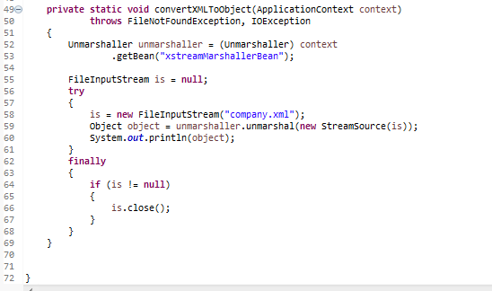
Spring and Xstream Integration (Marshalling Java Object into XML)

Slide 6
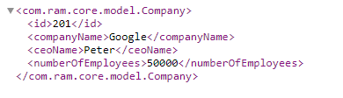
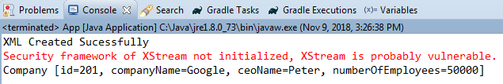
Spring and Xstream Integration (Marshalling Java Object into XML)
“company.xml” is generated in your project root folder

